Slide 1
SCTP
Stream Control transmission protocol

Slide 2
OBJECTIVES
The chapter has several objectives:
❑ To introduce SCTP as a new transport-layer protocol.
❑ To discuss SCTP services and compare them with TCP.
❑ To list and explain different packet types used in SCTP and discuss the purpose and of each field in each packet.
❑ To discuss SCTP association and explain different scenarios such as
association establishment, data transfer, association termination, and
association abortion.
❑ To compare and contrast the state transition diagram of SCTP with
the corresponding diagram of TCP.
❑ To explain the flow control mechanism in SCTP and discuss the
behavior of the sender site and the receiver site.
❑ To explain the error control mechanism in SCTP and discuss the
behavior of the sender site and the receiver site.
❑ To explain the congestion control mechanism in SCTP and compare
with the similar mechanism in TCP.

Slide 3
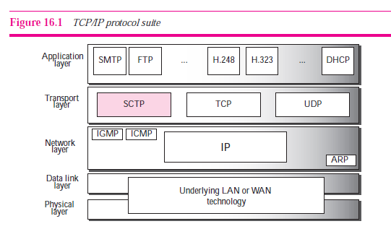

Slide 4
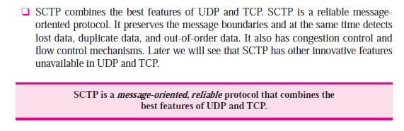

Slide 5
SCTP services
Process to process commn
Multiple streams
Multihoming
Full duplex
connection oriented
reliable

Slide 6
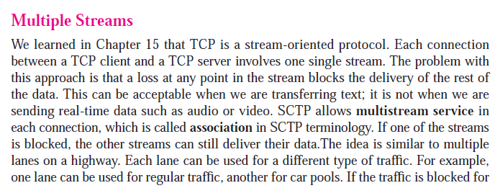
Multiple streams

Slide 7
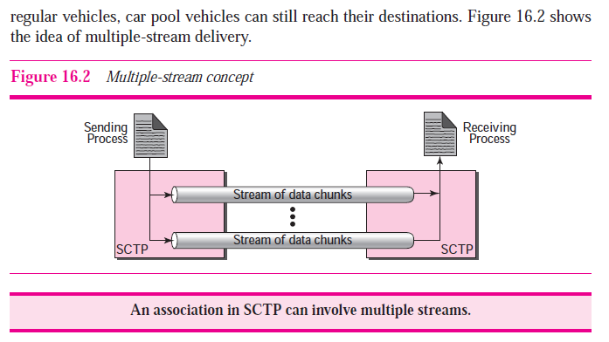

Slide 8
multihoming
A typical host or end-user network is connected to just one network.
In many circumstances, it can be useful to connect a host or network to multiple networks, in order to increase reliability (if a single link fails, packets can still be routed through the remaining networks), to improve performance (depending on the destination, it may be more efficient to route through one network or the other) and to decrease cost (depending on the destination, it may be cheaper to route through one network or the other).

Slide 9
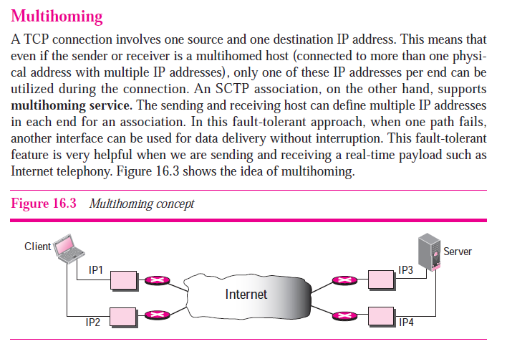

Slide 10
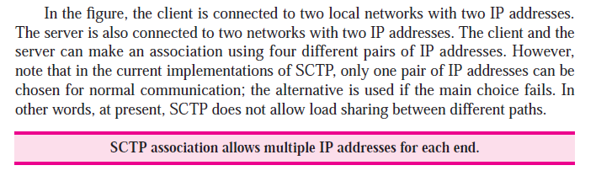

Slide 11
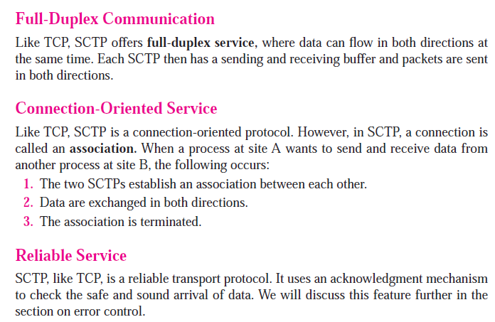

Slide 12
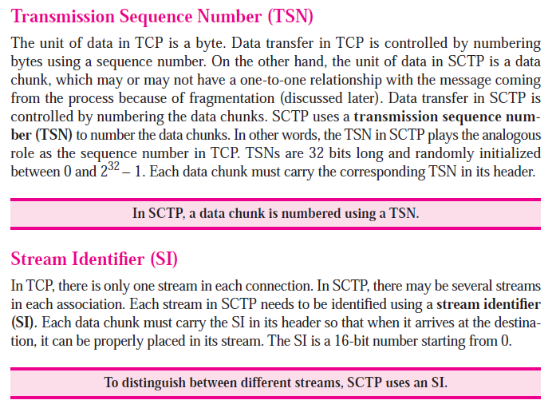
Sctp features

Slide 13
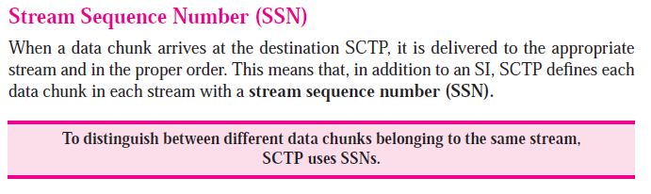

Slide 14
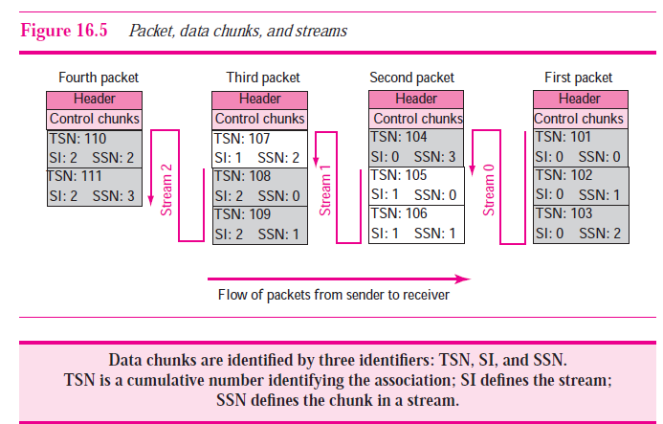

Slide 16
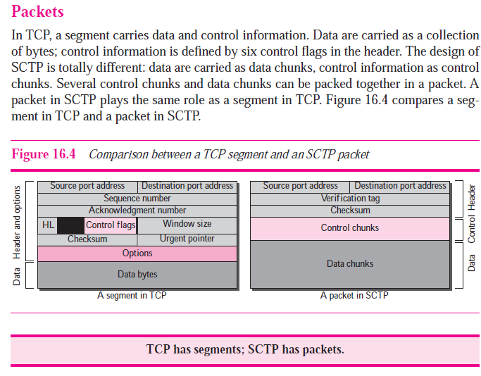

Slide 17
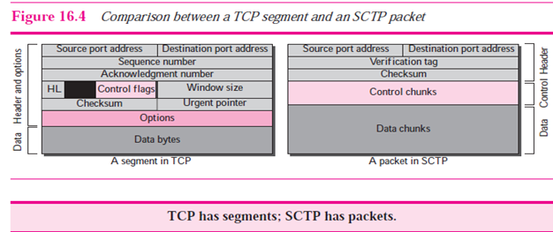

Slide 18
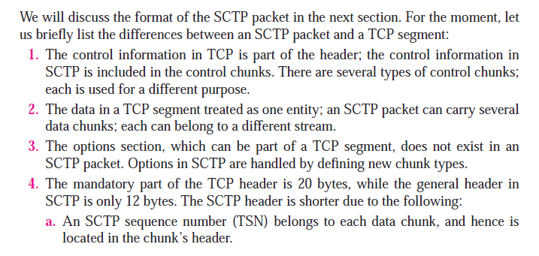

Slide 19
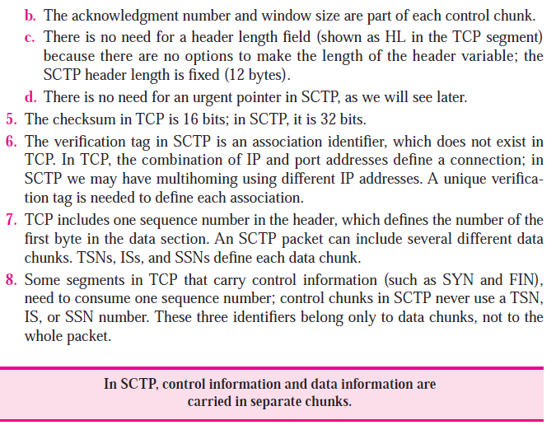

Slide 21
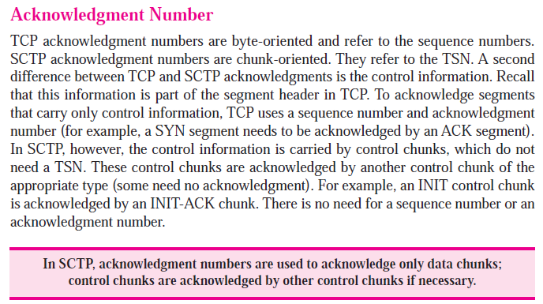

Slide 22
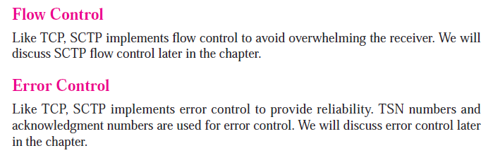
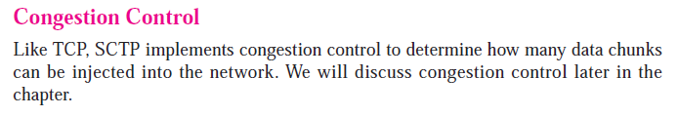

Slide 23
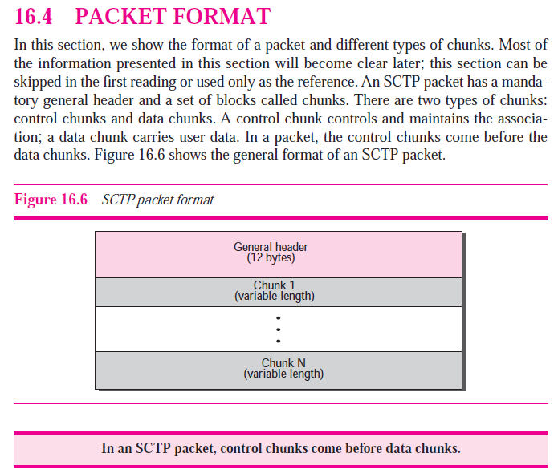

Slide 24
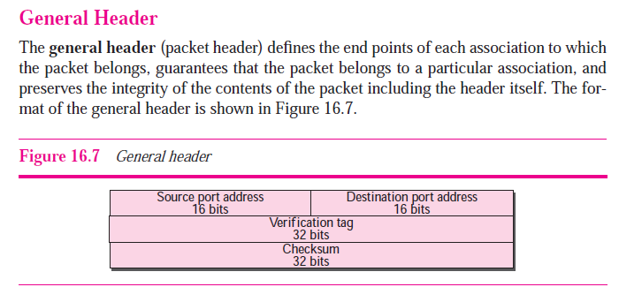

Slide 25
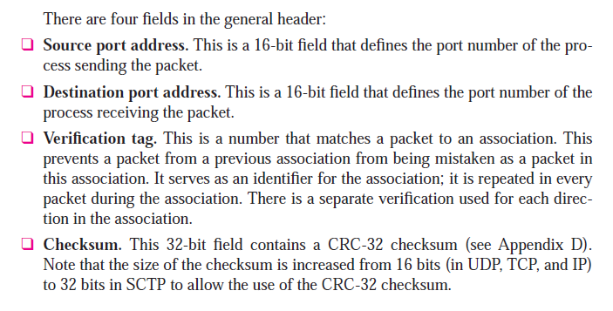

Slide 26
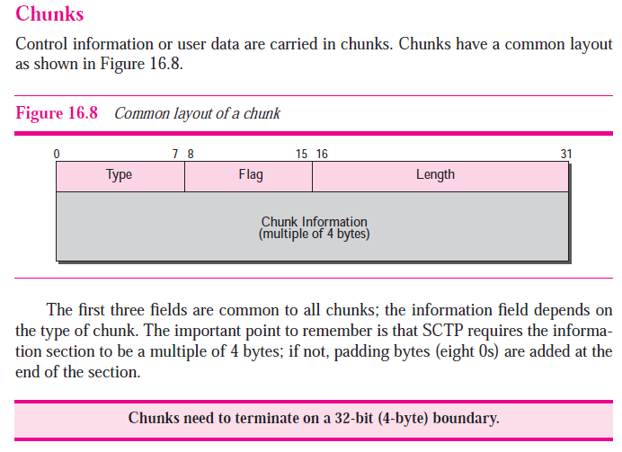

Slide 27
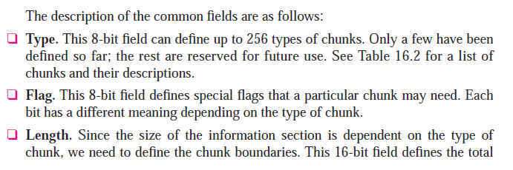
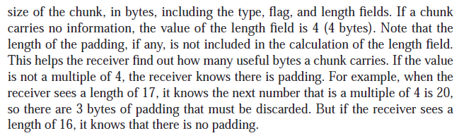

Slide 28
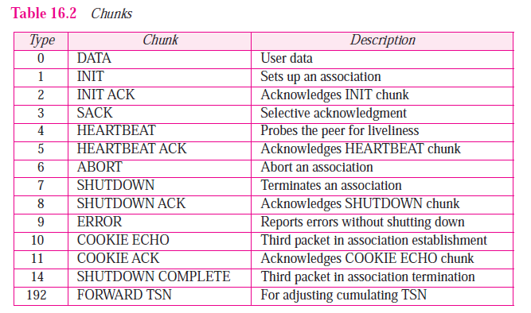

Slide 29
init
Init ack
Cookie echo
Cookie ack

Slide 30
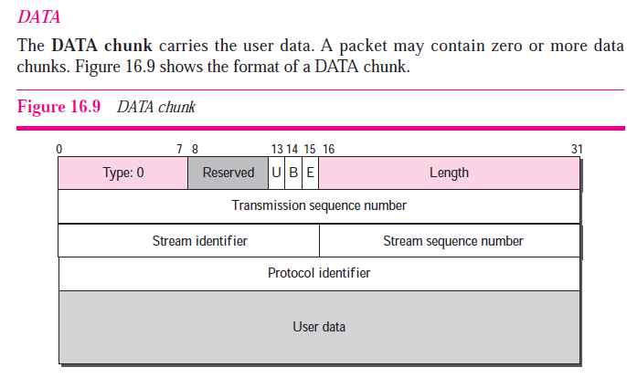

Slide 31
B | E | RESULT
1 | 1 | ONLY ONE DATA CHUNK (NO FRAGMENTATION NEEDED)
1 | 0 | FIRST FRAGMENT
0 | 1 | LAST FRAGMENT
0 | 0 | MIDDLE FRAGMENT

Slide 32
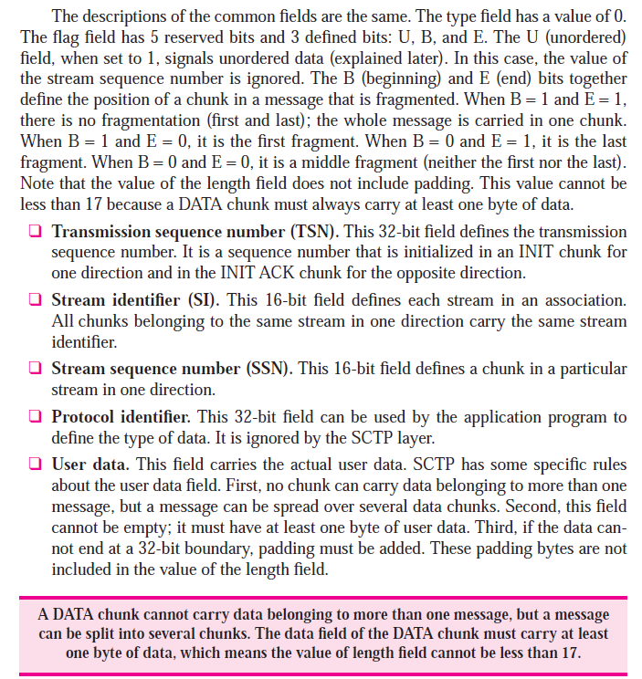

Slide 33
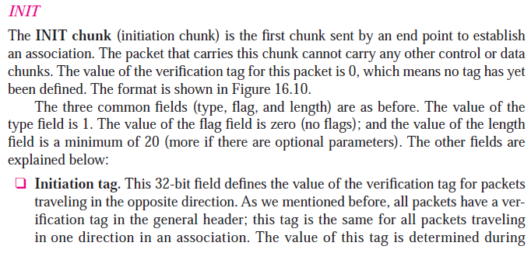

Slide 34
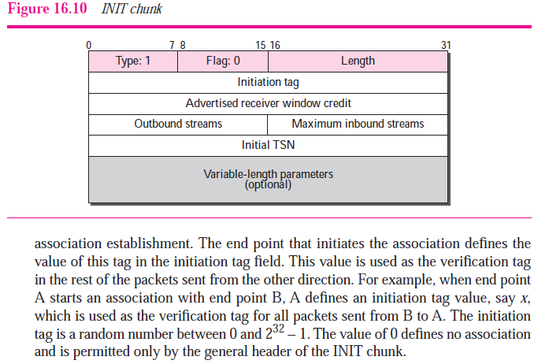

Slide 35
A
B

Slide 36
A
B
INITIATION TAG=X
verification tag: Y
VERIFICATION TAG=X
initiation tag:Y

Slide 37
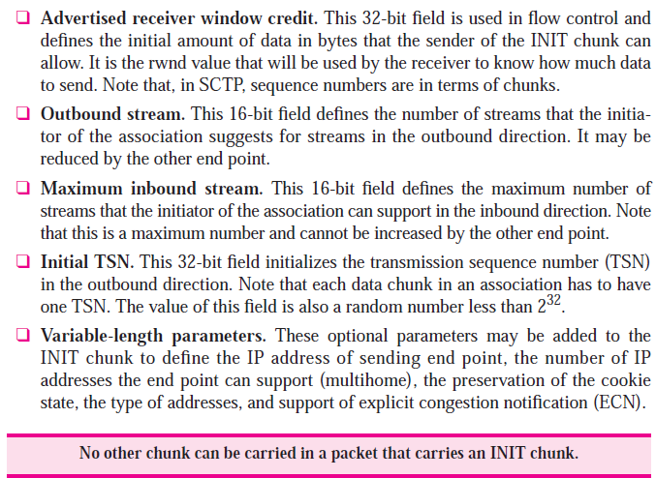

Slide 38



Slide 39
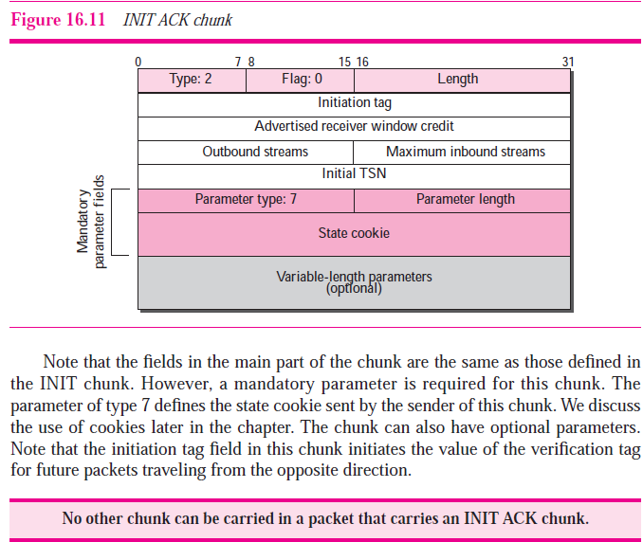

Slide 40
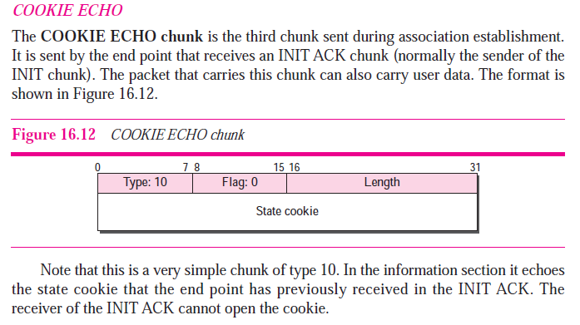

Slide 41
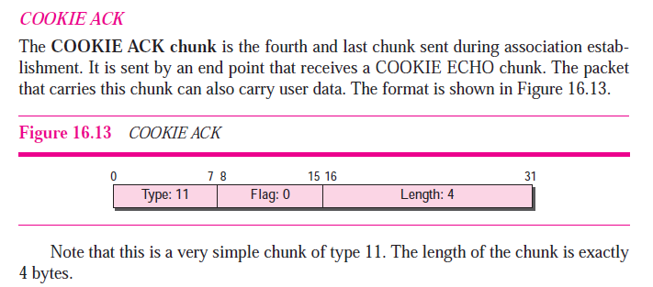

Slide 42
init
Init ack
Cookie echo
Cookie ack

Slide 43
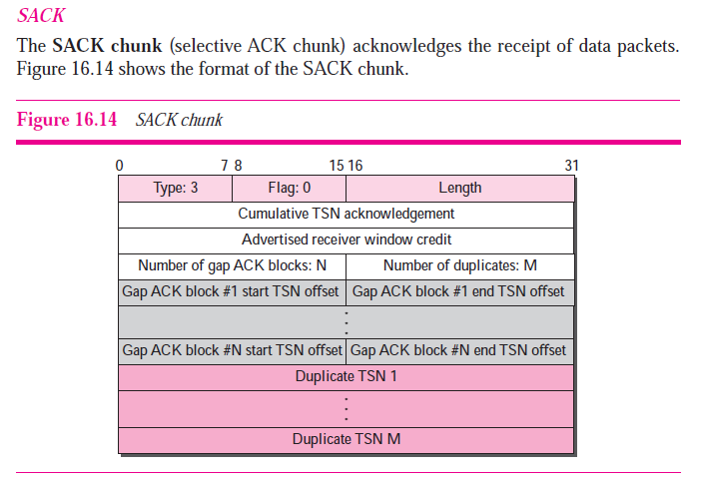

Slide 44
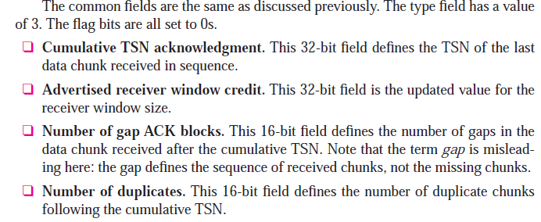
Important feature of SACK chunks is to indicate a gap in the transmission. This means that one or more DATA chunks are not received by the peer and they need to be retransmitted.
before the gap
i.e. How many gap acknowledgements are included in the chunk.
How many gap acknowledgements are included in the chunk.

Slide 45
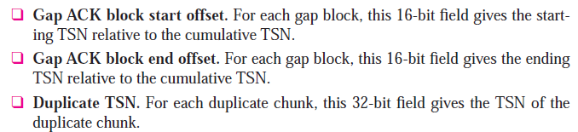

Slide 46
How are gaps reported?
It is possible to have gaps in the received data. This means that the receiver has received DATA chunk with TSN bigger than expected. In this case it will send a SACK chunk with 'Cumulative TSN ACK' set to the TSN of the DATA chunk just before the gap. Then 'Number of gap acknowledgement blocks' will be set to the number of gaps. All gap acknowledgement blocks will be inserted right after 'Number of duplicated TSNs' parameter. Each block has two integers:
Gap Ack Block Start: It contains the offset (please note that the value is offset, not a TSN) of the first DATA chunk in this block. This means that when we add the value of the 'Cumulative TSN Ack' parameter to this offset, we get the TSN of the first received message after the gap.
Gap Ack Block End: It contains the offset (again - offset) of the last DATA chunk in the block. When we add the offset to the value of the 'Cumulative TSN Ack' parameter, we get the TSN of the last received DATA chunk.

Slide 47
example
Let's see how this works in the real world with a simple example. There is an established association between hosts A and B ,and A send to B eight DATA chunks. The initial TSN value for A is 100. So the TSNs of the DATA chunks are from 100 to 107. Let's say that chunks 100, 101, 104, 105 and 107 are delivered successfully and for some reason chunks 102, 103 and 106 are not received by B. This means that there are two gaps in the transmission. The whole data flow is shown in fig. 3 and the gaps are marked. At this point B decides to reply with SACK chunk. Let's see what should be set in the chunk parameters:

Slide 48
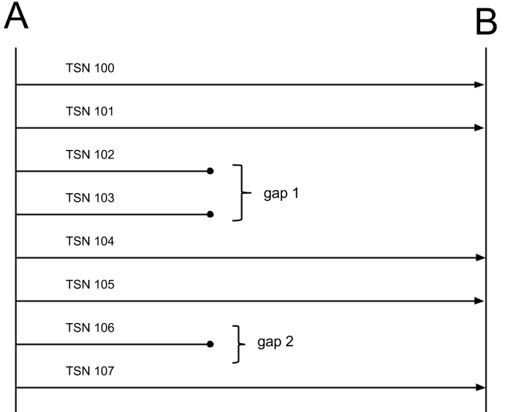

Slide 49
Cumulative TSN Ack: As you already know, this parameter contains the TSN of last received DATA chunk, before the gaps. In our case this is the TSN of the second message - 101.
Advertised receiver windows credit (a_rwnd): We are not interested in this parameter right now, so we'll just skip it.
Number of gap acknowledgement blocks: We have got two gaps, so the value of this parameter is 2.

Slide 51
First gap acknowledgement block:
Gap Ack Block Start: The first received DATA chunk after the gap is with TSN 104. Cumulative TSN Ack is 101. So the value of this parameter is 104 - 101 = 3.
Gap Ack Block End: The block contains two DATA chunks with cumulative TSNs. The TSN of the last chunk is 105. This means that the value of this parameter is 105 - 101 = 4.

Slide 53
Second gap acknowledgement block:
Gap Ack Block Start: The same logic works here. There is one lost DATA chunk, after the previous block. The TSN of the received chunk is 107. The value of the parameter is 107 - 101 = 6.
Gap Ack Block End: This block contains only one chunk, so the value of the parameter is again 6. Both start and end values are 6, which indicates that the block contains only one chunk.

Slide 54
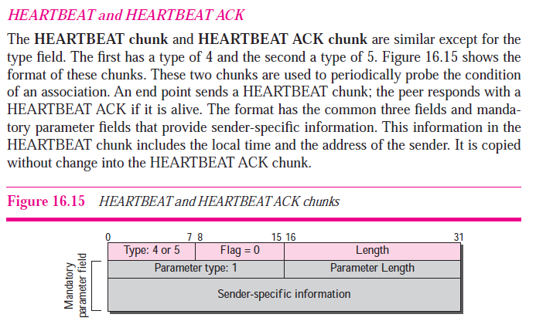

Slide 55
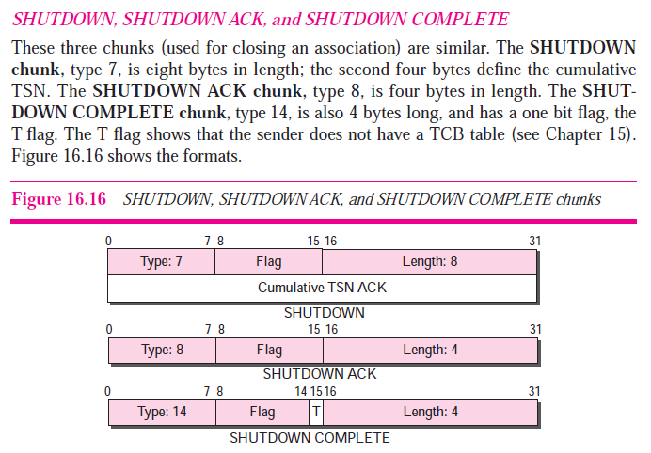

Slide 56
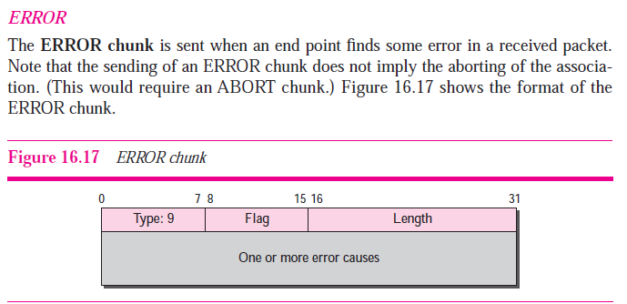

Slide 57
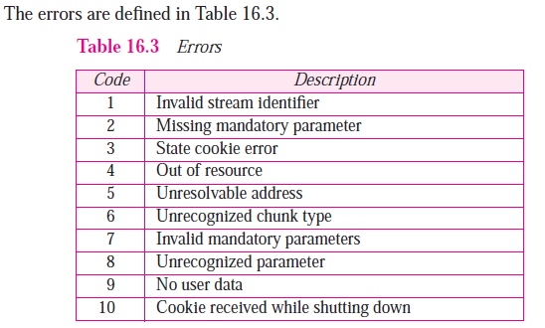

Slide 58
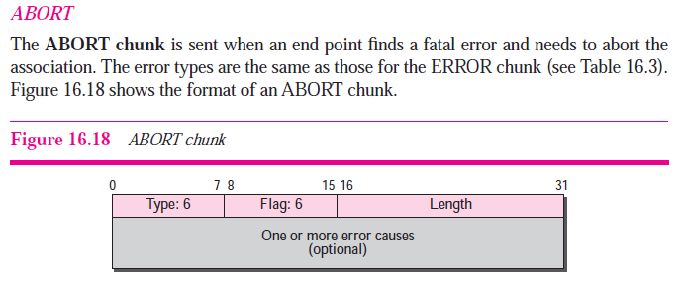
flag

Slide 59
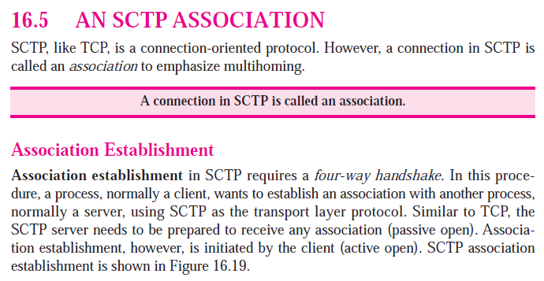

Slide 60
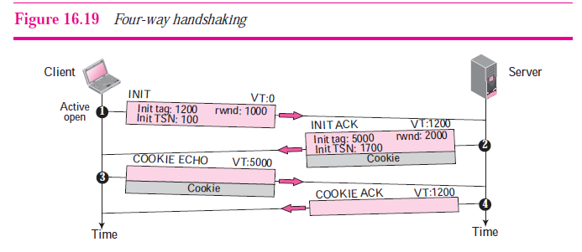

Slide 61


Slide 62
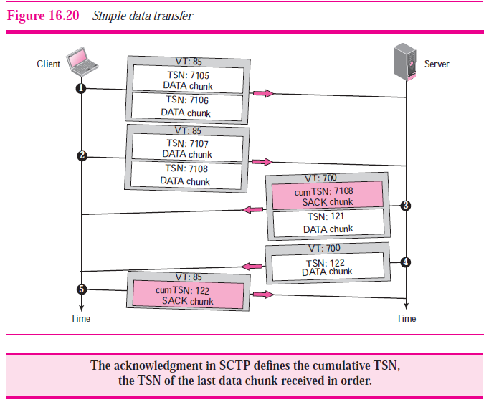

Slide 63
Data transfer
Simple
Multihoming
Multistreaming : ordered and unordered
fragmentation

Slide 64
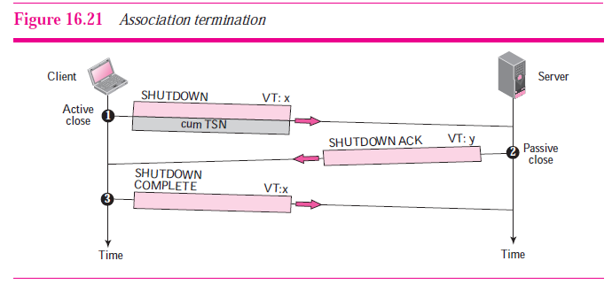

Slide 65
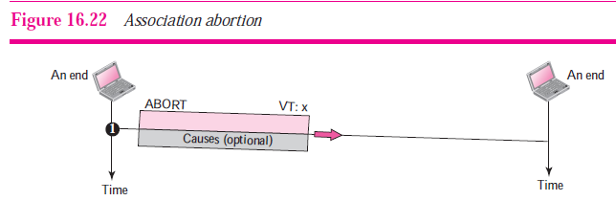

Slide 66
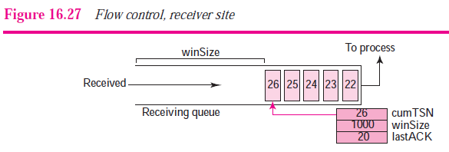
Flow control

Slide 67
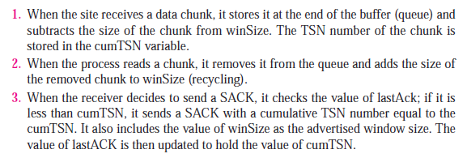

Slide 68
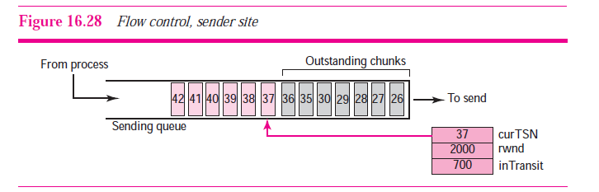

Slide 69
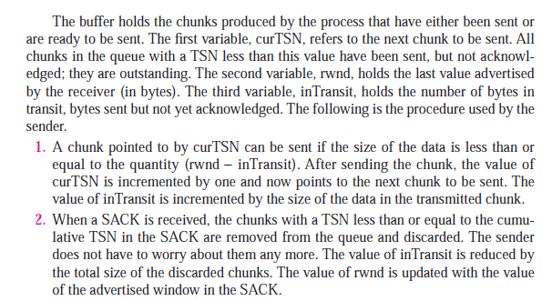

Slide 70
Error control

Slide 71


Slide 72
|23-26|=3
23-28=5
|23-31|=8
23-34=11

Slide 73


Slide 74

Congestion control

